Slide 1
Insight Learning

Slide 2
Introduction to Kohler
Kohler was born in Estonia, and earned his Ph.D from the University of Berlin in 1909 on psycho-acoustics.
From 1910 to 1913 he collaborated with Wertheimer and Koffka, working on the foundations of what would become known as "Gestalt" theory.
From 1913 to 1920, he was director of a research station in Canary Islands where he conducted behavioral research with animals.. Later he served as director of the Psychology Institute, Berlin.
In 1925-26 Kohler was a visiting professor at Clark University in the United States. In 1934-35 he was William James Lecturer at Harvard and in 1935 a visiting professor at the University of Chicago.
He came to the United States in 1934, where he became professor of psychology at Swarthmore College. Kohler is best known for the influence of his writings in the founding of the school of Gestalt psychology.

Slide 3
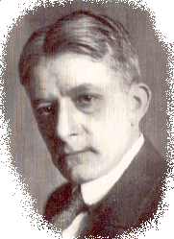
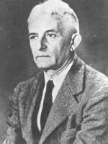

Slide 4
Kohler’s belief
In the 1920s, many scientists thought that animals could only learn through trial and error. They thought that when an animal faced a problem, such as finding food, it would stumble around until it hit upon the right answer by trying different actions until it got lucky. But Kohler believed that animals, especially chimps, were much smarter than most people imagined. He believed that chimpanzees were capable of intelligence, and even insight. To test his ideas he did several experiments.

Slide 5
Chimp Experiments
To get the bananas, the chimp would have to use an object as a tool. The objects in the play area included sticks of different lengths and wooden boxes.
He discovered that chimpanzees were very good at using tools. They used sticks as rakes to pull in bananas places out of reach. And they also used sticks as clubs to bring down fruit hung overhead.
Sometimes they stood long sticks on end and quickly climbed up the 7 meters and grabbed the bananas before the stick fell over. The chimpanzees also learned to use boxes as step ladders, dragging them under the hung bananas and even stacking several boxes on top of one another.

Slide 6
Kohler's chimps were able to do more than use tools, he actually observed chimps building tools. For example, he observed chimps breaking off branches from a tree to make a "rake."
One of the smartest chimps, Sultan, was given a very difficult problem. Kohler placed a bunch of bananas outside Sultan's cage and two bamboo sticks inside the cage. However, neither of the sticks was long enough to reach the bananas. Sultan pushed the thinner stick into the hollow of the thicker one, and created a stick long enough to pull in the bananas
Other chimps have been observed using a short stick to bring in a long stick, and then using the long stick to bring in a bunch of bananas. Kohler believed that these chimps showed insight -- acting as if they "saw" the solution before carrying out the actions. However, not all scientists agree with this idea

Slide 7
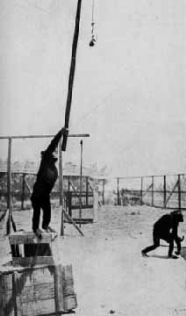
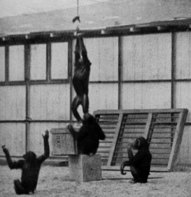

Slide 8
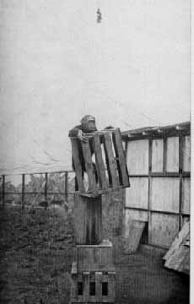
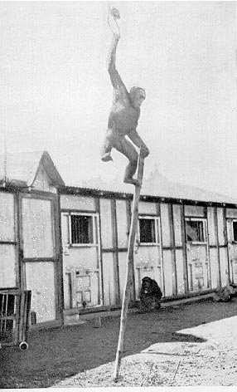
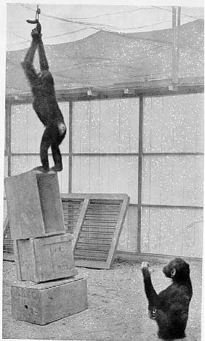

Slide 9
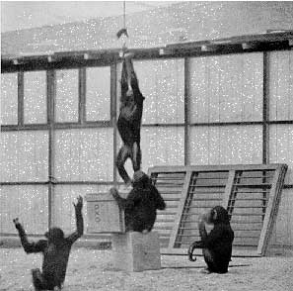
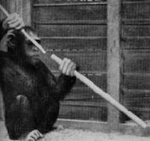

Slide 10
Definition
Insight learning is the abrupt realization of a problem's solution.
Steps
1. Identifying the problem
2. Understanding the Problem
3. Incubation of Ideas
4. Trail of Mode of Response

Slide 11
Steps
5. Sustained Attention
6. Insight Development
7. Steady Repetition of Adaptive Behaviour 8. Comprehension of Ability

